Slide 1

How to Make a Custom/Updated ESXi ISO
Russell Hamker
VMware Architect

Slide 2


Quote Slide: Leaf and Ocean Color Theme
Intro
Create a Tanzu Community Edition OVA Using HashiCorp Packer
About Me:
Russell Hamker
14+ years Running VMware
VCP5-2022
Employer – Guard Dog Solutions Inc
Title – VMware Enterprise Architect
vExpert – 7 years and running
VMUG Leader – Wichita KS
Twitter - @butch7903
Tanzu Vanguard

Slide 3
Why make an Custom/Updated ESXi ISO/Update Bundle
Allows for Easy Upgrades via Upgrade Baseline or ISO upgrade
Allows you to easily reload your host with the same ISO as you used for upgrading to current
Simplifies your business processes
Makes sure you have the right Vendor Drivers for the ESXi version you are on
Using an upgrade mythology protects your hosts from VIB drift, ensuring you have the same VIBs throughout all your hosts

Slide 4
What Is the Process to Create a Custom ISO?
Download my PowerCLI utility to automate this process
Download the VMware ESXi Vendor Bundle
Verify what the current build of ESXi is
Download updated VMware Tools.
Download ESXi Patches
Reference your Hardware Vendor’s support Matrix
Download updated VMware hardware drivers per your vendor’s Matrix
Run the PowerCLI Script and follow the instructions

Slide 5
Common Links - Download VMware Bundle/Tools/Patches
Download Zip Bundle
https://my.vmware.com/
VMware ESXi Build Numbers and Versions
https://kb.vmware.com/s/article/2143832
Download the latest VMware Tools Offline Bundle
https://www.vmware.com/go/tools
VMware ESXi Patch Downloads
https://my.vmware.com/group/vmware/patch#search

Slide 6
Common Links - Check Hardware Vendor Support Matrix
Cisco
https://ucshcltool.cloudapps.cisco.com/public/
HPE
http://vibsdepot.hpe.com/recipes/HPE-VMware-Recipe.pdf
Dell
vSphere 6
https://dl.dell.com/topicspdf/vmware-esxi-6x_reference-guide2_en-us.pdf
vSphere 7
https://dl.dell.com/topicspdf/vmware-esxi-7x_reference-guide_en-us.pdf
VMware Compatibility Guide
https://www.vmware.com/resources/compatibility/search.php

Slide 7
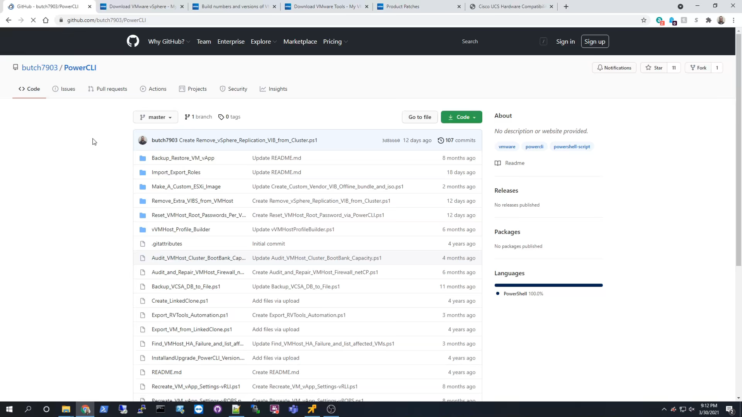

Slide 8




Thank you!
Russell Hamker
Enterprise Architect
Guard Dog Solutions
https://github.com/butch7903 https://github.com/guarddog-dev
Twitter: @butch7903
LinkedIn: https://www.linkedin.com/in/russhamker/

Slide 9
HEVC Codec for Presentation
Demo playback requires HEVC Codecs
To install:
Windows:
Via PowerShell: start ms-windows-store://pdp/?ProductId=9n4wgh0z6vhq
Install free codec pack for HEVC
MAC:
https://download.divx.com/stable/divx/DivXInstaller.dmg
Install dmg file

